Slide 1
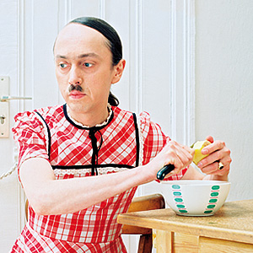
SC1101E WEEK 7
GENDER AND SEXUALITY
Kelvin Low Department of Sociology National University of Singapore

Slide 2
Overview
Explicating key terms
Learning & ‘Doing’ Gender
Theories of Gender
Inequality and Intersections
Conclusion

Slide 3
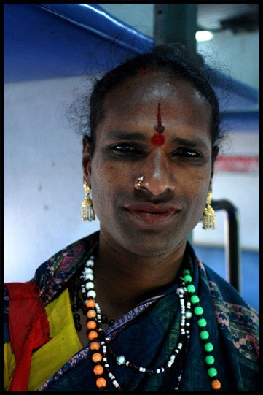
I. Key Terms
Sex – biological/anatomical differences
Only 2 sexes?
What about hermaphrodites or intersexuals?
Gender – a social construct
How a given society defines masculinity and femininity (cf. ‘race’ – stereotypes, traits, norms, roles)
Cross-cultural examples
Margaret Mead and New Guinea tribes
Hijras of India

Slide 4
I. Key Terms
Gender identity
Feeling of being male or female
Gender role
Behaviour associated with each gender
Sexuality
Sexual preferences/behaviour
Heterosexuality and homosexuality as inventions

Slide 5
A Brief History of Heterosexuality (and Homosexuality) as an Invention (Katz 2005)
Idea of the heterosexual did not exist; desire for sexual behaviour was for procreation and not pleasure
1820-1860
Notions of heterosexuality and homosexuality began emerging in the U.S. and Germany
1860-1892
Heterosexuality defined medically as a mental condition; heterosexuals regarded as ‘abnormal’
1892-1900

Slide 6
A Brief History of Heterosexuality (and Homosexuality) as an Invention (Katz 2005)
Heterosexuality becomes dominant culture; homosexuality perceived as a threat, hence the division of these two categories
1900-1945
Homosexuality associated with sterility; challenges to hetero/homo divide by Kinsey and Vidal
1945-1965
Critique of heterosexuality through the term ‘heterocentric’ by feminists and homosexual-rights activists
1965-1982
Notes:
Historially,a homosexual act not a homosexual individual.

Slide 7
Questions
What is the social function of sexual categorising?
Whose interests have been served by the division of the world into heterosexual and homosexual?
What happens if we do not make distinctions between these two categories of sexual behaviour?

Slide 8
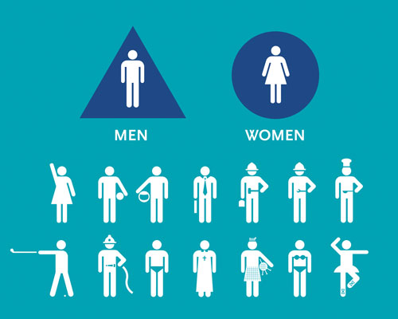
II. Learning & ‘Doing’ Gender
Socialisation - processes through which individuals take on gendered qualities and characteristics and acquire a sense of self
Socialisation as a two-sided process
Target of socialisation
Agents of socialisation

Slide 9
II. Learning & ‘Doing’ Gender
Examples of Gender Socialisation
Dressing/Colours
Toys – Girls learn how to be beautiful; Boys are socialised with traits of competition and aggression
Parental guidance/response
Mass Media
Notes:
Classification based on colours

Slide 10
II. Learning & ‘Doing’ Gender
‘Doing’ Gender – Key points
We all ‘do’ gender constantly – communicating our gender through how we wear our hair, clothes, and other mannerisms and behaviour
‘Doing’ gender in social interaction
Accountability – outcome is either gender-appropriate or inappropriate

Slide 11
II. Learning & ‘Doing’ Gender
Gender as social construct
Not natural
Not immutable
A product of social, cultural and historical forces

Slide 12
II. Learning & ‘Doing’ Gender
‘Doing’ gender – a means of organising and stratifying society
Division of chores and rewards of social life
Men and women are expected to be different
Different, and also unequal
Gendered traits of masculinity versus femininity

Slide 13
III. Theories of Gender
1. Essentialism
– gender differences in behaviour are traced back to biological differences between men and women
Another term: biological determinism
Talcott Parsons on natural differences between women and men
Historical perspectives
Notes:
Socially determined.

Slide 14
III. Theories of Gender
Critique of Essentialism
Historical and cultural variations of gender and sexuality are ignored
Methodological Problems – overemphasis on biological causation; neglect cultural values
Greater variation within than between sexes
Notes:
Men can be found in non-masculine roles these days.

Slide 15
III. Theories of Gender
2. Functionalism
each sex has a role to play
norms and values promote gender role conformity
learning essential features of masculinity and femininity = proper functioning of society
gendered specialisation of tasks
Notes:
Extension of functionalism.

Slide 16
III. Theories of Gender
Critique of Functionalism
Gendered division of labour constitutes only a small percentage
Gender segregation is not absolute
Women combine work in the private and public sphere as well
Notes:
Especially in post-industrial era.

Slide 17
III. Theories of Gender
3. Symbolic Interactionism
Key points
Gender as a socially constructed idea
Masculine and Feminine roles are learnt
Gender roles in everyday social interaction
Human agency and active ‘doing’ of gender
‘Doing’ gender as everyday occurrence

Slide 18
III. Theories of Gender
4. Conflict Perspective
Males = haves
Females = have-nots
Women less access to power → dependent on men
Women in subordinate roles → men control

Slide 19
III. Theories of Gender
4. Conflict Perspective – Engels
1. Male domination in class inequality
2. Men dominated over and protected women
3. Male physical control → control by ideology
4. Rules of inheritance; monogamy
5. Capitalism → more wealth available to men/sons
6. Ideologies to justify male domination and female subjugation
7. Maintain position of privilege
8. Control over institutions and resources
Notes:
Monogamy- only have one partner

Slide 20
III. Theories of Gender
5. Feminist Perspective
- Apart from male dominance being rooted in capitalism, one key variable is patriarchy
- Patriarchy broadly refers to male dominance in society across public and private life:
(1) patriarchal culture
(2) paid employment
(3) violence

Slide 21
III. Theories of Gender
5. Feminist Perspective
Key points:
1. Women will continue to be oppressed until patriarchy is eliminated.
2. Bringing about a new and equal ordering of gender relationships.
3. Understand causes of women’s lower status; seek ways to change systems.
Notes:
On the basis of equal treatment, have control over ur body

Slide 22
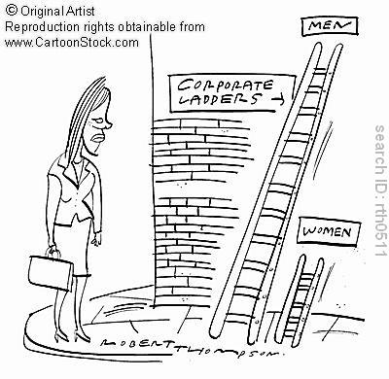
IV. Inequality
Gender distinctions →→ gender inequality
Gender hierarchies are produced due to the meanings that are attached to gender differences
Differential assignment
Question: How are structures of gender inequality produced and reproduced in societies?

Slide 23
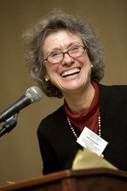
IV. Inequality
1. Earnings Gap
Gender discrimination – men and women are rewarded differently for the same work; discrimination in terms of being denied promotion or being fired with no legitimate reason
Heavy domestic responsibilities – notion of ‘second shift’ (Arlie Hochschild) faced by women due to cultural expectations that lead to gendered division of labour

Slide 24
IV. Inequality
1. Earnings Gap
III. Women in low-wage occupations/industries – women take up low-paying jobs and are underrepresented in higher-paying positions
IV. Undervaluation of women’s labour – work done by women considered less valuable than men’s work; arbitrary standards of rewards

Slide 25
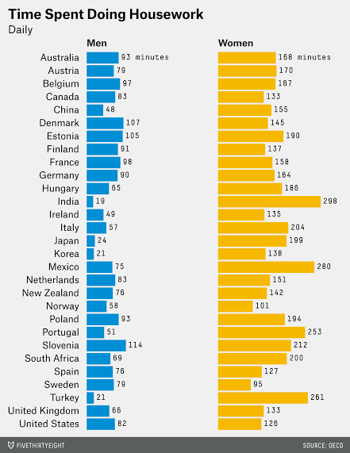
In the developed world, measuring gender equality often means looking at the pay gap. But what happens outside the workplace can also provide insight into how the genders differ, and a new report suggests that there’s still a huge imbalance in housework.
Women do more routine housework than men in all of the 29 countries surveyed by the Organisation for Economic Co-operation and Development (OECD). A lot more housework — an average of 173 minutes per day, compared to just 71 minutes for men.
http://fivethirtyeight.com/datalab/internationally-women-still-spend-more-time-doing-chores/?utm_content=buffer030b9&utm_medium=social&utm_source=facebook.com&utm_campaign=buffer

Slide 26
IV. Inequality
2. Male Aggression Against Women
Rape as linked to expressions of power and dominance instead of mere gratification
Sexual harrassment implies a culture of male domination

Slide 27
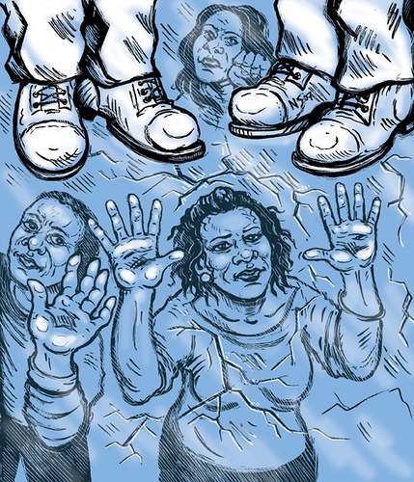
IV. Inequality
3. Blocked advancement/ Glass ceiling
Vertical segregation at workplace
Women occupy lower positions while men get promoted faster
Glass ceiling - an invisible but impenetrable barrier to the upper levels of management
Example – women as attorneys

Slide 28
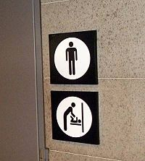
IV. Inequality
Question: Is it possible to have a degendered society?
Degendering institutions – practices/policies indifferent to gender
Degendering interaction – interaction not dependent on identifying maleness or femaleness
Degendering individuals – gender no longer the organising principle of people’s traits
Notes:
Why is there a need to make a distinction.

Slide 29
IV. Intersections of Race, Class, and Gender
Race, class, and gender work together in modifying or intensifying one’s subjugation in society; they cross-cut
Two examples
1. Puerto Rico – Black girls and women face discrimination because of their physical traits; discrimination in employment
2. North African Women in France – Muslim women from Tunisia, Morocco, Algeria face ethnic discrimination

Slide 30
IV. Intersections of Race, Class, and Gender
Double or Triple discrimination
Examples
Indigenous black women in Latin America and the Carribean face three-fold discrimination because of their sex, race, and social class
Indigenous women experience access to resources and positions of power differently from non-indigenous men and women
Triple discrimination therefore points to differential treatment because they are women, they are indigenous, and they are poor

Slide 31
V. Conclusion
Key terms
Sex, gender, sexuality
Gender identity; gender role
Learning/Doing Gender
Socialisation
Gender as social construct

Slide 32
Essentialism | Biological differences between men and women to account for gender differences
Functionalism | Gender role conformity, specialisation of tasks, division of labour
Symbolic Interactionism | Gender as a social construct, attachment of meanings to interaction
Conflict Perspective | Women are subordinated, men in control with privileged status
Feminism | Women’s oppression understood through patriarchy

Slide 33
V. Conclusion
Gender Inequality
Double shift/glass ceiling
Degendered society?
Intersections
Double/Triple discrimination
Levels of Analysis
Individual
Interactional
Institutional

